Slide 1

We are the creative one.
Promax came into to existence with its range of artistically crafted Chairs in the heart of Bangalore. Being a perfectionist our self, we manufacture chairs of ample varieties which are icons on its own terms. Our vision to move along with the latest trends has made us what we are now. We thrive on innovation. Our collections are exquisite and serves the purpose to fullest. Give a completely new outlook to your space with our finest collection of chairs.
Promax Chairs

Slide 2
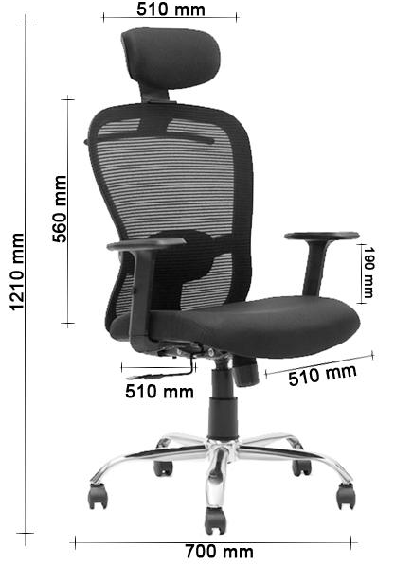
Model Name:- Butterfly HB
Model Details | Regular Market Price | Dealer price Promax dealer offers | Exclusive price for SAP Employees
Butterfly High back chair with adjustable height and lumbar support, single position lock, Metal base with nylon wheels | 8000 | 6520 | 5400*
Same Chair With Multi lock position | 8500 | 6650 | 5875*
Warranty 3 years on any manufacturing defects except for hydraulic, Hydraulic or gas lift will have 1 year warranty
* 1)The price given is ex factory, transportation as actual.
2) The price is inclusive of GST and one single chair with all features as given.

Slide 3
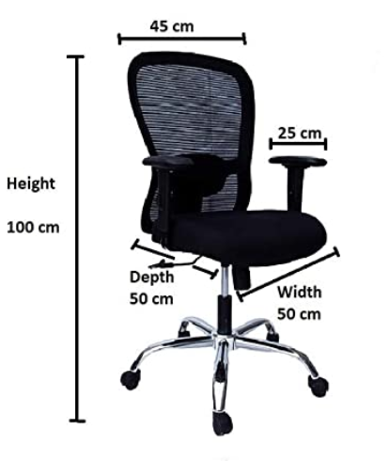
Model Name:- Butterfly MB
Model Details | Regular Market Price | Dealer price promax dealer offers | Exclusive price for SAP Employees
Butterfly Medium back chair with adjustable height and lumbar support, single position lock, Metal base with nylon wheels | 7400 | 5920 | 4700*
Same Chair With Multi lock position | 7900 | 6395 | 5175*
Warranty 3 years on any manufacturing defects except for hydraulic, Hydraulic or gas lift will have 1 year warranty
* 1)The price given is ex factory, transportation as actual.
2) The price is inclusive of GST and one single chair with all features as given.

Slide 4
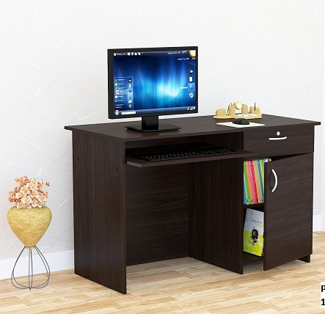
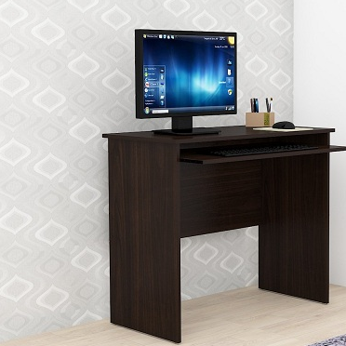
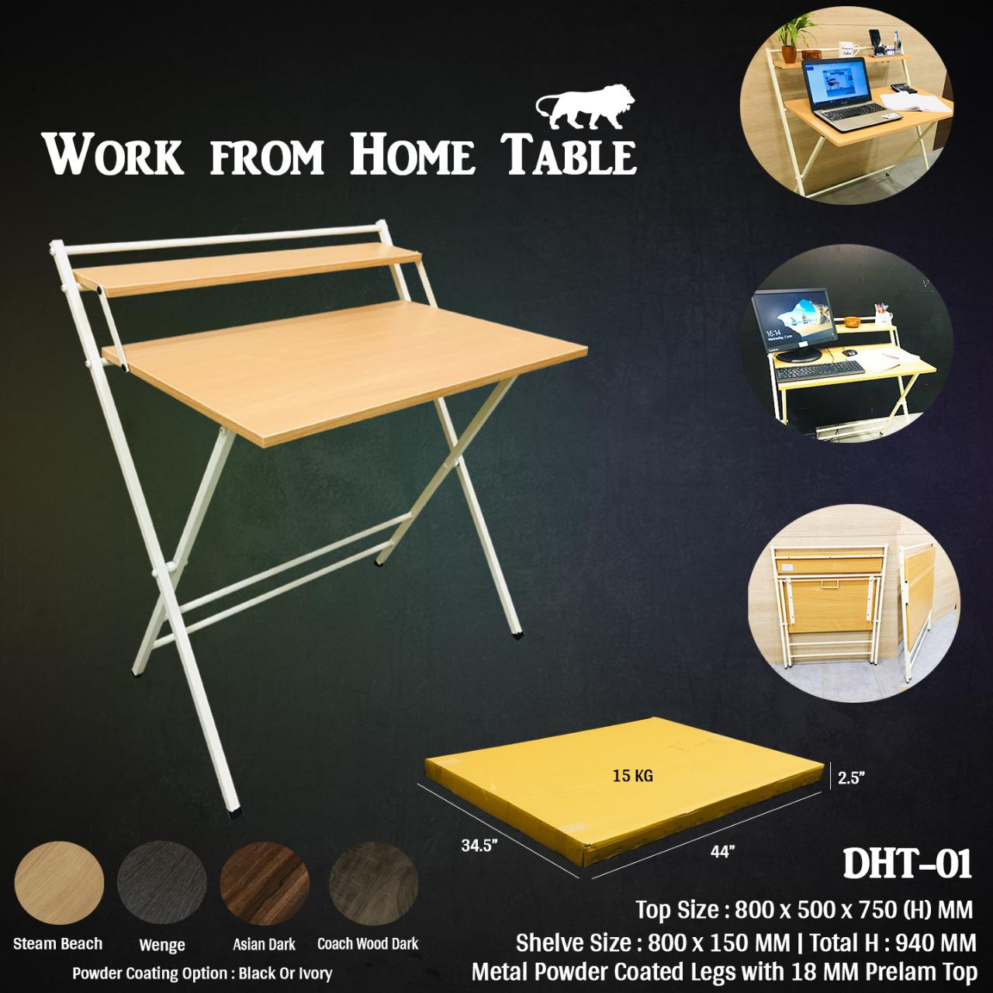
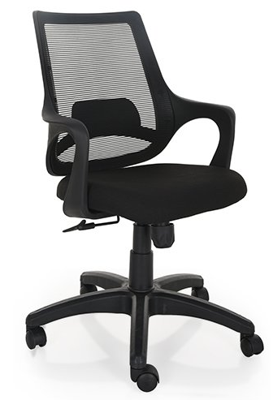
More WFH Products at Promax
Wambley Table
Bosco Table
Size: W750*D450*H750MM
Size: W1200*D600*H750MM
MRP: 10750/-
SAP PRICE: 6343/-
MRP: 7600/-
SAP PRICE: 4484/-
DHT–01 Foldable Table
Mono chair
For small space
Size: W800*D500*H750MM
MRP: 6400/-
SAP PRICE: 3776/-
MRP: 4800/-
SAP PRICE: 2832/-

Slide 5




THANK YOU
Contact Us
Address:
No-22, Ashwatkatte Road,
Kasturiba nagar, Mysore road,
Opp street of shell Petroleum,
Bangalore- 560026
Contact Number:
Mobile No : 9986345136
Phone : 9611794899
Email Id :
nikhil@promaxchairs.com
For any kind of service related issues or complaints contact: Mr. Nikhil (Operation head) +919742423333
This Quotation is valid till September End, Any order placed after that will not be as same terms.

